Slide 1
Infection Prevention Challenges and Training Needs in Nursing Homes and Assisted Living Facilities, Virginia, 2010
Andrea Alvarez, MPH
Dana Burshell, MPH, CPH
Virginia Department of Health
Healthcare-Associated Infections Program
June 13, 2011

Slide 2
Virginia and Infection Prevention Outside Acute Care
Primary goal of Virginia’s Healthcare-Associated Infections (HAI) Program: To improve patient/resident outcomes across the continuum of care
Impetus for shifting educational focus away from acute care
Outbreaks in assisted living facilities (ALFs) and nursing homes (NHs)
Strongly suggested by acute care infection preventionists (IPs) when the HAI program first explored Virginia’s infection prevention needs
Increasing interest and support of Virginia ALFs, NHs, and
long-term care organizations/partners
Notes:
Our program seeks to improve patient/resident outcomes across the continuum of care. Reaching out to assisted living facilities and nursing homes has been an important part of working toward this goal. A history of outbreaks in ALFs and nursing homes has put these settings on the health department’s radar. Acute care infection preventionists also suggested that our program reach out directly to these settings, as they are in need of training and resources and may be very receptive to our assistance. Long-term care providers and organizations have also been supportive of us shifting our programmatic focus.
***********************
Federal organizations and other states are also increasing their interest in preventing infections in long-term care facilities. Virginia is one of the few states we are aware of working directly not only with nursing homes, but also assisted living facilities – which pose very different challenges and needs. We are excited to share with you what we have learned and look forward to bringing what we learn from you back to our facilities. Guidance and tools specific to the unique needs of this setting are being developed, including a long-term care module of the National Healthcare Safety Network which we are interested to see upon implementation.
***********************************

Slide 3
Notes:
This graph shows the number of outbreaks that have occurred in ALFs and nursing homes over the last five years.
Assisted living facilities have been required to report outbreaks since 2008. Over this 5 year time period, over 800 outbreaks (n=803) were reported in ALFs and NHs, representing about ½ (52%) of all outbreaks in the state during this time period.
From 2006 to 2010, norovirus and flu were the most common pathogens causing outbreaks in nursing homes and assisted living facilities. The overwhelming majority of outbreaks – 78% in assisted living and 69% in nursing homes were caused by norovirus. About 1 in 10 outbreaks in these settings were caused by influenza. Several other conditions caused outbreaks during this time period, including Acinetobacter, Clostridium difficile, hepatitis B, the common cold, rotavirus, and scabies.
Of the ALF and NH outbreaks, 58% occurred in ALFs and 42% occurred in nursing homes.

Slide 4
Purpose of Needs Assessment
Identify infection prevention training needs and preferred training formats in assisted living facilities and nursing homes
Highlight differences in infection prevention resources and challenges between ALFs and NHs
Ascertain inconsistencies between facility policies, implementation of those policies, training needs, and infection prevention challenges
Notes:
The purpose of the assessment was to identify infection prevention training needs and preferred training formats, highlight differences in infection prevention resources and challenges between the two settings, and ascertain inconsistencies between facility policies, training needs, and infection prevention challenges. Frequencies and analyses were conducted using SAS v. 9.2.

Slide 5
Methods
Questions adapted from CDC’s Long-Term Care Baseline Prevention Practices Assessment Tool and VDH’s acute care infection prevention needs assessment
Reviewed by Long-Term Care Advisory Committee
Pilot tested by 9 facilities
Distributed via SurveyMonkey
Paper copy made available if requested
September – October 2010
Target respondent: infection prevention main point of contact at the facility
Frequencies and analyses conducted using SAS
Notes:
In fall 2010, we distributed an online needs assessment to ALFs and nursing homes. In all, 36 stand-alone ALFs and 88 nursing homes responded. The results of the assessment indicated a need for more education and information sharing.

Slide 6
Demographics of Respondents
ALFs (stand-alone)
36 respondents (11%)
25% had a registered nurse (RN) as main point of contact (POC)
LPN (33%)
Admin (28%)
22% part of chain/corporation
Average bedsize = 67
NHs
88 respondents (34%)
20 facilities had AL beds as well
91% had a RN as main POC
LPN (6%)
Physician (2%)
68% part of chain/corporation
Average bedsize = 117
Notes:
Respondents: stand alone ALFs=36, NHs=88
Sent to: ALFs (n=531) and NHs (257). Response rate: ALFs response rate was 11% (n=56) of which 64% (n=36) were stand-alone ALF facilities. NH response rate was 34% (n=88) of which 23% (n=20) also had assisted living facilities.
The 88 NHs included 20 facilities that also had an ALF.
Taking into consideration the low response rate, it is clear from this data that ALFs are less likely to have a clinician as their infection prevention main point of contact (~1/4th), and of the clinicians, it is more often an LPN than an RN. In the NH setting, all main POCs are clinicians, of which 90% are RNs.
NHs were more likely to be part of a chain or corporation (68% vs. 22%) and had almost twice the average number of beds in their facilities.
¼ of ALFs did not have a clinician as the POC

Slide 7
Top Infection Prevention Training Needs vs. Reported Challenges: ALFs
Training Needs
Outbreaks
Transfer of residents
Educating residents about infection risk-reduction behavior
Multidrug-resistant organisms
Challenges
Infection risk-reduction behavior compliance for visitors
Providing sufficient IC information and training for staff
Infection risk-reduction behavior compliance for residents
Infection risk-reduction behavior compliance for vendors or contractual staff
Tracking infections
Notes:
A higher percentage of ALFs reported having training needs for most of the topics offered. However, when focusing on the top training needs in each type of facility, ALFs top training needs were outbreaks and transfer of residents (which could partially address their reported challenge of tracking infections); educating residents about infection risk-reduction behavior (which could address their challenge of resident, visitor, and vendor/contractual staff compliance with infection prevention practices) and multidrug-resistant organisms (which can partially address the challenge of providing sufficient infection control info and training to the staff.

Slide 8
Top Infection Prevention Training Needs vs. Reported Challenges: Nursing Homes
Training needs
Outbreaks
How to educate regarding infection risk-reduction behavior for vendors/contractual staff, visitors, and/or residents
Environmental cleaning and disinfection
Reported challenges
Employee hand hygiene compliance
Environmental cleaning compliance
Infection risk-reduction behavior compliance for visitors
Infection risk-reduction behavior compliance for residents
Notes:
NH’s top training needs and reported challenges appear to go hand in hand also. Nursing homes, which did not report as high of training needs for as many areas, top training needs included outbreaks (like ALFs), learning how to educate vendors/contractual staff, visitors, and/or residents regarding infection risk-reduction behavior (which could address their reported challenges infection risk-reduction behavior compliance for visitors and residents) and environmental cleaning and disinfection (would could address their reported challenge of environmental cleaning and possibly even employee HH compliance).
Both types of facilities seem to always want more information about outbreaks and struggle with how to provide ongoing education and ensure infection control compliance from all of the people passing in and out of their facilities everyday.

Slide 9
Services Provided by Facility Type
Service provided | Nursing Home | Assisted Living Facility
Glucose monitoring | 98% | 97%
Wound care | 100% | 67%
Blood draws | 100% | 51%
Foley (urinary) catheter | 98% | 44%
Central lines | 90% | 14%
Peripheral lines | 94% | 8%
Management of residents with a tracheostomy | 78% | 8%
Notes:
Drives home that BGM really should be a priority in both settings and that NHs have different types of patients and services, creating a different set of challenges for infection control. We hear again and again that nursing homes have become step-down units, and ALFs have become the nursing homes of a few years ago with residents with more needs. However, regulations and guidance are far behind and ALFs are more prone to not have the staff, resources, and knowledge to adequately provide safe services for their residents. In addition, the constant pressures of the bottom line of ensuring as many beds are filled as possible for both sets of facilities sometimes forces them to admit residents that are not a good fit for the facility whether it be because they have acute care needs or that they have an MDRO that the long-term care facility may not be able to fully provide transmission-based precautions. This poses a risk for the residents, the staff, and other healthcare facilities who receive these patients again when they return to the acute care setting.

Slide 10
Most Frequent Infections by Facility Type
 | First | Second | Third | Fourth | Fifth
Nursing Home | UTI 90% | Pneumonia 83% | MRSA 77% | CAUTI 71% | SST 66%
Assisted Living Facility | UTI 71% | Influenza 35% | Pneumonia 33% | Norovirus 26% | SST 19%
CAUTI= catheter-associated urinary tract infection
MRSA= methicillin-resistant Staphylococcus aureus
Pneumonia: percentage does not include ventilator-associated pneumonia (VAP)
SST= skin and soft tissue infections
UTI= urinary tract infection; percentage does not include CAUTI
Notes:
Percent of facilities that said the type of infection occurs “sometimes” or “often”
The differences in NH and ALF infections may be partially due to a difference in tracking practices. Moreover, residents in ALFs may go to a hospital or NH when having more severe infections and conditions. Nevertheless, urinary tract infections appear to be the most common infection in both types of settings. Pneumonia and skin and soft tissue infections also land in the top 5 types of infections in both types of facilities. However, it is clear that influenza, norovirus, and MRSA are commonly in both types of facilities.

Slide 11
Top Methods to Identify Infections by Facility Type
Notes:
This graph was used in the training sessions to show how important observing the resident is, especially in ALFs. We used this as a springboard to talk about ways to identify residents who may have an infection that may be specific to these settings… for example, a slight change of temperature, not remembering to put on their watch like they do every other day. This also gave us an avenue to discuss the importance of the entire staff team including dietary, environmental services, and volunteers who may get to know a resident and may be the first one to be aware of any subtle/significant changes that may lead to early detection and treatment of an infection.
At the same time, the ability to review lab reports and antibiotic orders are important to take into consideration to help target treatment, but should only be used when looking at the entire clinical picture. We have heard again and again that practices still exist to screen or run tests when there are no symptoms, indicating a colonization and may lead to inappropriate antibiotic use, and that some facilities and physicians may still test for negative results to stop treament, which may lead to extended and inappropriate use of medications.

Slide 12
Tracking Methods by Facility Type
Tracking Method | Nursing Home | Assisted Living Facility
Log/spreadsheet | 87% | 38%
Electronic database | 24% | 16%
Does not track | 0% | 48%
Notes:
The facilities also differed in their ability to track data. All nursing homes said they tracked data with most using a log or spreadsheet and a quarter using some version of an electronic database. Nearly half of ALFs did not track infections. Of those who do, over half use a log/spreadsheet and less than a quarter have started using electronic databases.
It is clear that the two types of facilities may need different educational materials, support, and guidance concerning their surveillance practices.
It may indicate that ALFs may not be aware of the communicable dangers actually present in their facilities, preventing them from being able to take appropriate action.

Slide 13
Percent of Facilities Tracking Infections by Infection Type and Facility Type
Notes:
ALFs may be more likely to track the diseases that typically cause outbreaks in their setting like influenza and norovirus and some of the more common infections like UTI and skin and soft tissue infections; however, they are less likely to track MDROs and C. difficile

Slide 14
Hand Hygiene Policies, Training Needs/Practices, and Challenges by Facility Type
Notes:
Although 43% of nursing homes identified staff hand hygiene compliance as a top infection prevention challenge, 78% said that no training on hand hygiene was needed.
Clearly, ALFs and NHs are very aware that they need policies to address these issues to prevent getting “dinged” by licensing agencies. However, they are less likely to implement these policies, especially when it comes to new hires, exposing a vulnerable area of these types of facilities. Many facilities may not feel that they want to invest and train staff if they do not stay for a longer period of time or maybe their resources are limited and training upon employment is what is sacrificed. However, if staff are not trained immediately, they may develop bad habits that are difficult to break and may create more risk in the environment to staff and residents, which may ultimately cause morbidity and/or mortality.
Other cross-cutting topics included BBP exposure control policies and procedures, env cleaning, MDROs, std prec, and transmission-based precautions

Slide 15
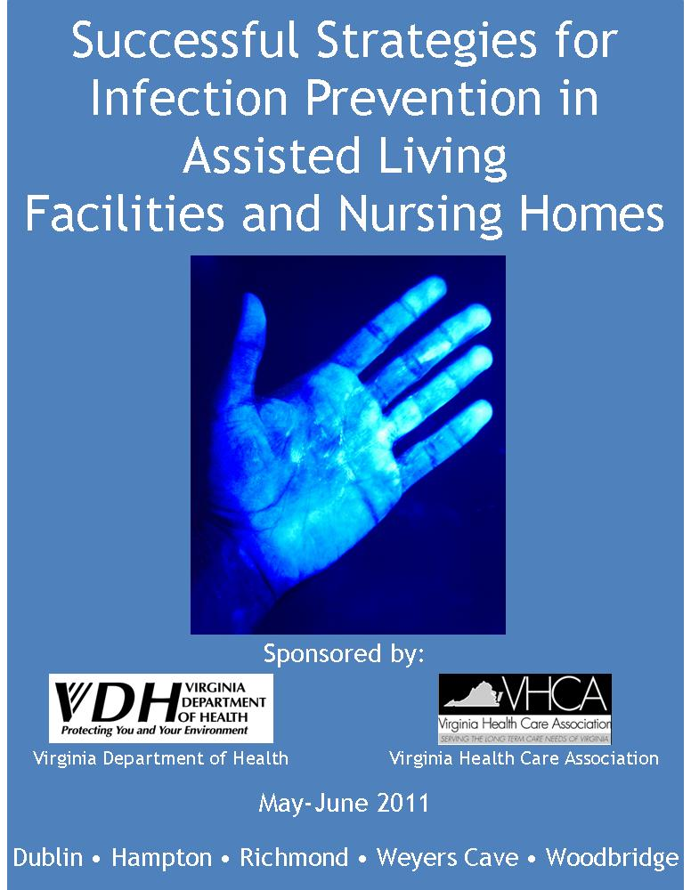
Successful Strategies for Infection Prevention in Assisted Living Facilities and Nursing Homes Training and Toolkit
Notes:
This toolkit contains infection prevention presentations, resources, and tools that have been adapted for the assisted living facility and nursing home setting whenever possible. Include a DVD to make copies, share materials with others, and customize as necessary.
Used results of needs assessment to identify topics to be addressed by toolkit resources and used LTC Adv Comm and local health dept staff for feedback. Edited by providers as well as local HD staff.
5 regional trainings, who we worked with and who came to present at the trainings (licensure, IPs from acute and LTC, health department staff, etc.), the two types of sessions (presentation vs. interactive)

Slide 16
Topics Covered
Routes of disease transmission and chain of infection
Standard and transmission-based precautions
Hand hygiene and personal protective equipment
Surveillance and outbreak investigation
Environmental cleaning and disinfection
Bloodborne pathogens, safe injection practices, and blood glucose monitoring
Vaccination
Staying home when sick (staff and visitors)
Transfer of residents
Working with your health department and licensing agency
Notes:
A lot of good debate about best practices and challenges seemed to center around transfer of residents, sick staff and facility policies, how to actually implement standard and transmission-based precautions, and how and when to screen for TB and record it properly.

Slide 17
Feedback from Training Evaluations
Planned uses of toolkit
Improve current practices, including surveillance and monitoring
Use templates to ensure policies address all areas of infection prevention
Training/in-service tool
Educate residents and family members
Share with multiple audiences including independent living, housekeeping, dietary staff
“Toolkit will be very useful. I loved receiving information that was both educational and easy to take back for use. Toolkit is FABULOUS!”

Slide 18
Future Projects for VDH HAI Program
Continue to disseminate toolkit (binder / DVD):
ALF and NH staff, local health department staff, and staff from licensing agencies
Enhance website to place all toolkit materials online
Nursing home prevention collaborative
Infection prevention needs assessment report
Continue to strengthen partnerships between the health department, all healthcare facilities, and the public
Notes:
For the remainder of the ARRA grant period, which runs to the end of 2011, we plan to continue to disseminate the toolkit that you all are receiving today. This is a standardized set of infection prevention resources to be used by facility staff as well as local health departments and licensing agencies. We will use the website as a way to update information and add new resources as they are developed.
These infection prevention trainings for provider trainings will be continued throughout the summer and local health departments plan to reach out to other providers who are unable to attend. Licensing inspectors will receive a similar training in October.
We will be implementing the nursing home prevention collaborative mentioned earlier and depending on its success, may look to expand that in the future. Our needs assessment results will be published in a report. Lastly, we want to continue to communicate with our partners and strengthen our relationships.

Slide 19
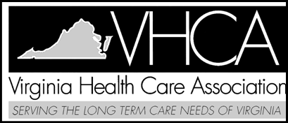
A Collaborative Effort: Thank You!
Andrea Alvarez
Virginia Department of Health
Healthcare-Associated Infections Program Coordinator
804-864-8097
Andrea.Alvarez@vdh.virginia.gov
Notes:
The needs assessment and the associated regional trainings have been a collaborative effort and we would like to thank the organizations on the slide who are represented on our Advisory Committee as well as the ALF and nursing home staff who responded to the assessment.

Slide 20
Percent of Responding Facilities Aware of and Addressing OSHA BBP Standard by Facility Type

Slide 21
Percent of Facilities Addressing Standard Precautions Through Facility Policies or Training by Facility Type
Notes:
Nursing homes and assisted living facilities in Virginia are required to address standard precautions in their facility policies, annual training and training upon employment

Slide 22
Percent of Facilities Addressing Transmission-Based Precautions Through Facility Policies or Training by Facility Type

Slide 23
Percent of Assisted Living Facilities Addressing Vaccinations Through Facility Policy and Vaccination

Slide 24
Percent of Nursing Homes Addressing Vaccinations Through Facility Policy and Vaccination

