Slide 1
Integrated Security and Confidentiality Guidelines for HIV and STI: Chicago’s Experience
Nanette Benbow, M.A.S
Director
STI/HIV Surveillance, Epidemiology and Research Section
Chicago Department of Public Health

Slide 2
Overview
Background
Organizational Structure
Need for integrated policies
Process of developing integrated policies
Program operation differences in security and confidentiality
Use of supplemental funds to develop, expand and improve policies
Conclusions

Slide 3
Background
1997 - Integrated STI/HIV Division
2001 - HIV surveillance moved from Epidemiology Section to Communicable Disease Bureau
2003 - HIV surveillance moved to STI/HIV Division
Integrated Surveillance, MMP, Incidence and NHBS
2010 - Integrated STI/HIV Surveillance
HIV surveillance data matched with other diseases by HIV surveillance staff and findings shared in aggregate with other programs

Slide 4
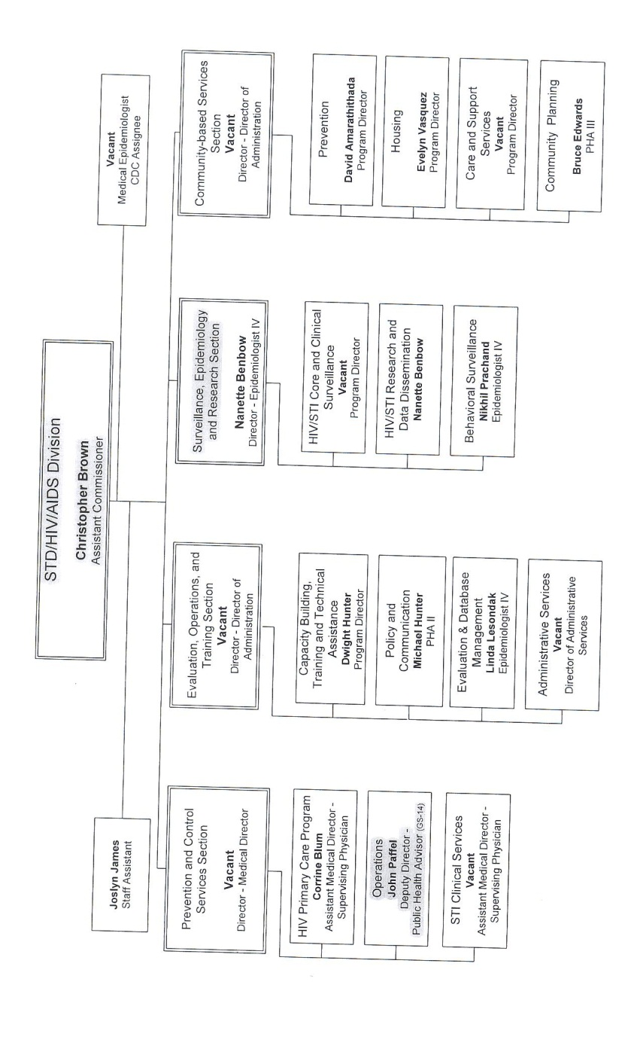
Organizational Structure

Slide 5
Need for Integrated Policies
Same practices across programs within the Division
Importance of using HIV surveillance for disease control
Partner service’s use of HIV surveillance data on new positives
Identification of new positives for Expanded Testing Initiatives
Identifying linkage and retention in care
STI/HIV/TB co-infection analyses
TB program’s need to know HIV infection status of TB patients

Slide 6
Process of Integration
Collaborated with STI surveillance staff , Director of Partner Services and Regional CDCI Supervisor
Develop shared language, expectations and commitment around security and confidentiality
Cross-walk HIV surveillance security and confidentiality guidelines with STI surveillance, partner services and TB programs’ operations (no guidelines available for other programs)
Identify differences in program practice and physical security that did not meet guidelines
Identify changes/compromises to draft integrated guidelines

Slide 7
Key Differences (1)
Need to ensure their security and confidentiality procedures
TB and some STD data in state-administered database
HIV surveillance data in STD*MIS for partner services
Partner services using detailed HIV surveillance data out in the field
MMP and NHBS collect data on handhelds
GC&CT surveillance system can be accessed from any location with internet access

Slide 8
Key Differences (2)
Physical space not amenable to be as restricted as HIV surveillance
Faxing of STI morbidity reports is a necessary and common practice
Field staff do not always have access to secure printers and faxes
Confidential information on STI could potentially be left on voice mail

Slide 9
Items in CDC’s Guidelines Not Currently addressed in CDPH’s Policy
Be explicit regarding use of cell phones and personal digital assistants (PDAs) with cameras and/or video recorders in secure areas.
Address circumstances and procedures for remote work in the event of an emergency or outbreak response
Update confidentiality and security protocols to address migration from paper-oriented data to electronic devices that meet established and evolving electronic and procedural security standards for fieldwork
Mechanisms to share/transport confidential information electronically, e.g. sFTP

Slide 10
Use of S&C Supplemental Funds (1)
Compared Security and Confidentiality Program Requirement Checklist with current practice of STI surveillance and Partner Services
Observed current practices and identified the following:
Systems/databases containing patient information (STD*MIS, C&T Database, INEDSS, etc) and current security measures needed to be modified or further investigated to meet requirements
Minimum data fields necessary to initiate HIV Partner Services to be entered into STD*MIS and mechanisms needed to share such data
Confidential information used in the field and document storage
Name and location of staff who have access to confidential information
Strengths and weaknesses of handling of confidential information and made recommendations to ensure compliance
Need for targeted training for field staff

Slide 11
Use of S&C Supplemental Funds (2)
Used HIV surveillance supplemental funds to:
Inform and develop content of training for field staff on new guidelines
Compare Security and Confidentiality Program Requirement Checklist with TB, Viral Hepatitis and Ryan White Program
Collaborate with Program Directors of other programs to define process and develop shared guidelines
Improve physical security of stored documents, including purchase of shredders, desk locks, and re-location of confidential information

Slide 12
Conclusions
Integration of security and confidentiality policies is a process that requires:
Good communication and collaboration across programs at all levels
Time to identify differences in local program operations and resources
Time to develop a shared vision and implementation plan
National vision of combined security and confidentiality guidelines
New uses of secure and confidential surveillance and other programmatic data are constantly being developed which will require constant review and expansion of policies

Slide 13
www.Cityofchicago.org/Health
Facebook.com/ChicagoPublicHealth
@ChiPublicHealth
(312) 747-9884
HealthyChicago@cityofchicago.org
http://gplus.to/ChiPublicHealth

