Slide 1
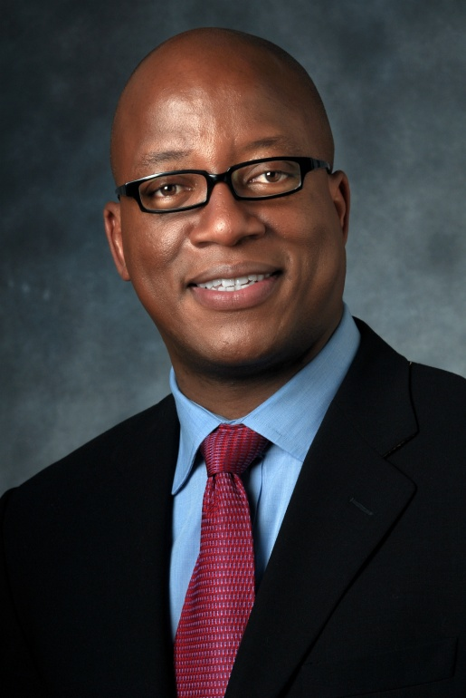
Introduction to the NCHHSTP Data Security and Confidentiality Guidelines Webinar
Kevin Fenton, M.D., Ph.D., F.F.P.H.
^{Director}
National Center for HIV/AIDS, Viral Hepatitis, STD, and TB Prevention
Centers for Disease Control and Prevention
Atlanta, GA
April 10, 2012
National Center for HIV/AIDS, Viral Hepatitis, STD, and TB Prevention
Office of the Director

